Slide 1
WEB & Mobile Application development
Module – 02
JS Class 02
Saylani Mass IT Training Faisalabad
Instructor : Umair Azmat
WhatsApp : +923217061116

Slide 2
JavaScript
JavaScript is an interpreted, client-side, event-based, object-oriented, scripted language.
Interpreted: Code is executed line by line at runtime, rather than being compiled beforehand.
Client-side: The code is executed on the user's browser, rather than on the server. Just tell what to do! Not how to Do!
Event-based: Responds to user events such as clicks and hovers.
Object-oriented: Follows an object-oriented programming paradigm and allows for the creation of objects with properties and methods.
Scripted: The code is written in scripts and executed in a sequential manner.
It was introduced in 1995 for Netscape Navigator and has since been adopted by all major web browsers.
JavaScript is Case-Sensitive. (Ahmed vs ahmed )

Slide 3
JavaScript
JavaScript is a high-level programming language used for web development.
"Java is to JavaScript what car is to carpet.”
It is the most popular and widely used programming languages in right now
Facebook - The main frontend of the website is built using JavaScript, React and Redux.
Netflix - The frontend for the video streaming platform is built with JavaScript.
Walmart - The retail giant uses JavaScript for both frontend and backend web development.
Airbnb - The popular home-sharing platform has a large JavaScript codebase, using React on the frontend.
PayPal - The online payment system uses JavaScript for both frontend and backend development.
Uber - The transportation network company uses JavaScript extensively for building its web and mobile applicat

Slide 4
What JavaScript can do?
Dynamic Web Interactivity: Enables user interaction with web pages without reloading the page, making it a key component of modern web applications.
Validation and Data Manipulation: Provides client-side form validation, data processing, and manipulation, reducing the load on servers.
Development of Browser Extensions: Allows developers to create browser extensions to extend the functionality of browsers.
Server-side Processing: Can also be used on the server-side through technologies such as Node.js, providing the capability to build full-stack applications.
Creating Games: JavaScript is capable of creating simple to complex games that can run in the browser.
Animation and Effects: Allows for the creation of animations, special effects, and visual transitions in web pages.

Slide 5
JavaScript Libraries vs. Frameworks:
JavaScript Libraries | JavaScript Frameworks
jQuery | Angular
Lodash | React
Moment.js | Vue.js
Swiper.js | Ember.js
Chart.js | Backbone.js

Slide 6
camelCase vs PascalCase
 | Camel case | Pascal case
Definition | First word in lowercase, subsequent words capitalized | Every word capitalized
Example | firstName, lastName | FirstName, LastName
Common use in programming | Variable and function names | Class, enum, and constant names
Example programming language | JavaScript, Java, C# | C++, C#, Java

Slide 7
Adding Js
Internally:
By adding script tag in index.html
< script >…. </script>
Externally
By Creating New File and adding through tag
<script src=“script.js”></script>

Slide 8
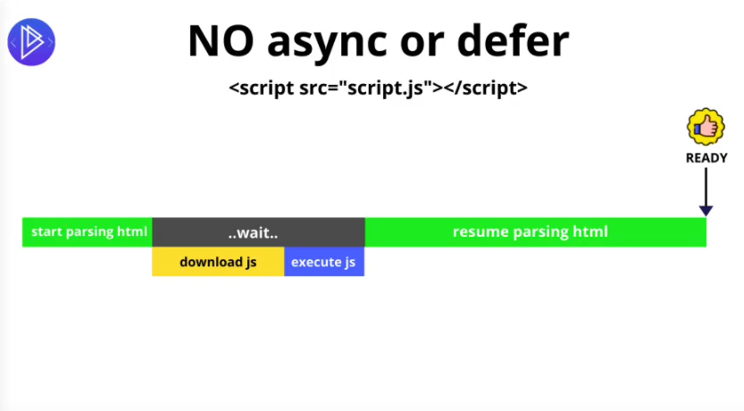
Js Loading Stratigies (async vs defer)

Slide 9
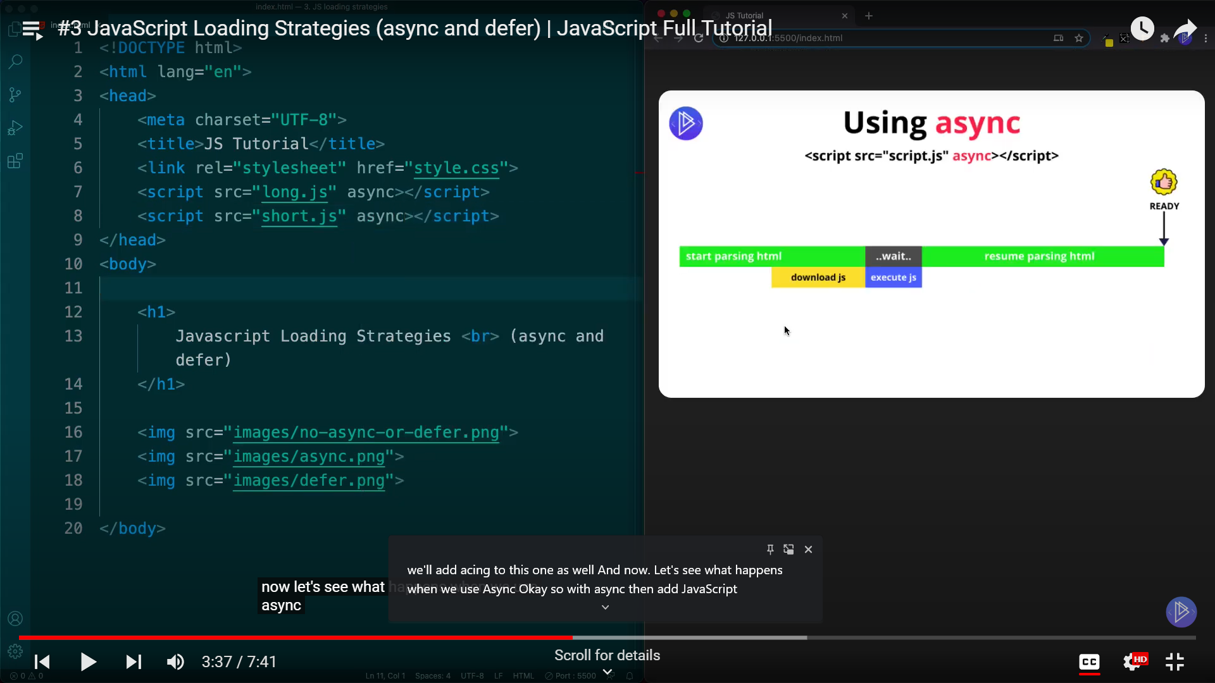
Using Async
Load First - Run First
First run short File and then Long File
It does not care about order
Not recommended to use when files are dependent on each other
Recommended to use for Analytics

Slide 10
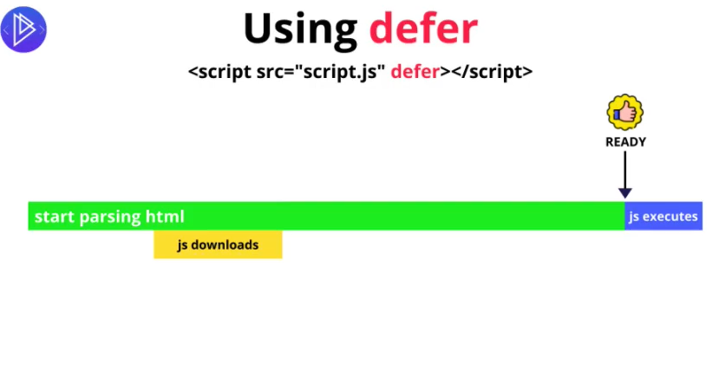
Using Defer
Html is never blocked
It execute files with order on first come first serve.
Recommended to use when files are dependent on each other

Slide 11
JS syntax Output Comments

Slide 12
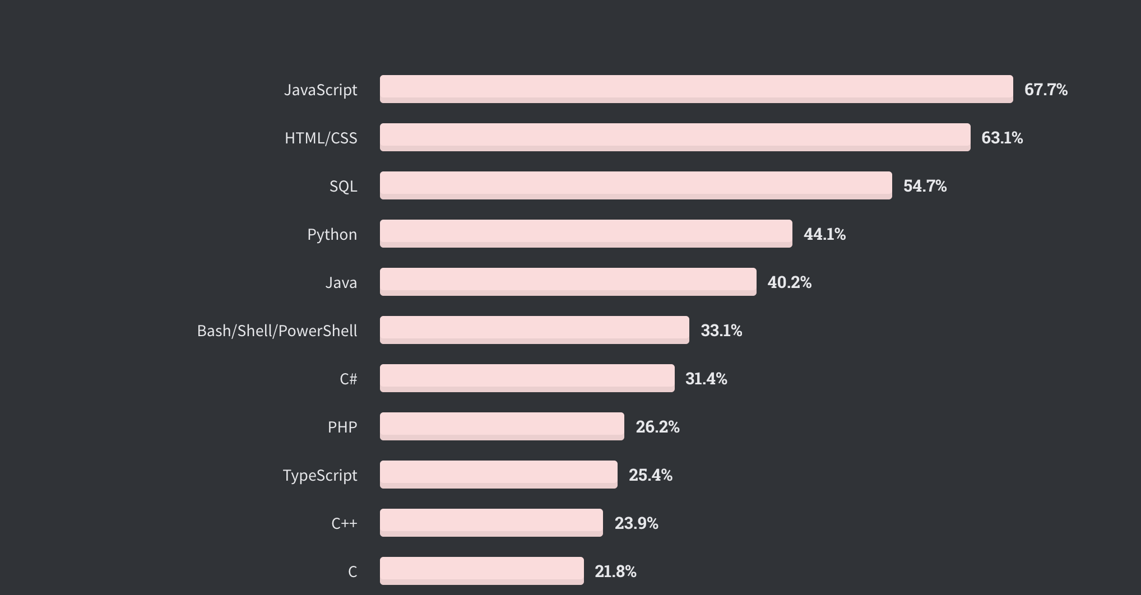
JavaScript Popularity
According to the 2022 Stack Overflow Developer Survey , JavaScript is the most popular coding language.

Slide 13
Thanks!
Do you have any questions?
umairazmat8115@gmail.com
+923217061116 umairazmat.me

